Slide 1
Playfair Cipher
Polyalphabetic substitution
The first practical digraph substitution cipher.
Digraph means a pair of two characters are encrypted at a time.
It was named after Lord Playfair but invented by Charles Wheatstone in 1854.
It fast and does not requires any special equipment.
A 5x5 matrix is used to create encoding and decoding matrix.
As we have 26 characters in english alphabet and only 25 place in matrix. One character is ignored.

Slide 2
Playfair Cipher
Polyalphabetic substitution
The first practical digraph substitution cipher.
Digraph means a pair of two characters are encrypted at a time.
It was named after Lord Playfair but invented by Charles Wheatstone in 1854.
It fast and does not requires any special equipment.
A 5x5 matrix is used to create encoding and decoding matrix.
As we have 26 characters in english alphabet and only 25 place in matrix. One character is ignored.

Slide 3
Playfair Cipher
Generating key square matrix
Steps in playfair cipher:
Generate key square matrix.
Group plaintest in pair of two.
Use the key square matrix for encryption.
Use the key square matrix for decryption.
Let we consider the key as: monarchy
Total number of characters : 8 = 5 + 3
Now to create 5X5 matrix.
The key is placed in matrix first.
M | O | N | A | R
C | H | Y

Slide 4
Playfair Cipher
Let we consider the key as: monarchy
Total number of characters : 8 = 5 + 3
Now to create 5X5 matrix.
The key is placed in matrix first.
Now, the rest of characters in alphabets.
I and J both are placed in one cell
M | O | N | A | R
C | H | Y | B | D
E | F | G | I/J | K
L | P | Q | S | T
U | V | W | X | Z

Slide 5
Playfair Cipher
Plaintext grouping
Rules for groping plaintext:
All the characters in the plaintext are divided into pair of two characters.
In case of same characters in a pair a false character is used to separate them. Example: Apple becomes Apxple , where x is a false character.
Now the pairs are [ [A,p ] , [x,p] , [l,e]]
In case if the number of characters in the given plaintext is odd a false character is used to make it even.
Example: Apples becomes Apxplesx , where x is a false character.
Now the pairs are [ [A,p ] , [x,p] , [l,e], [s,x]]

Slide 6
Playfair Cipher
Encryption
Rules for groping Encryption:
Same column : if both the letters are in same column.
Example: ME
Then take the below character.
So [ M, E ] => [ C, L]
NOTE: if the given letter is U then the encrypted letter will be M.
M | O | N | A | R
C | H | Y | B | D
E | F | G | I | K
L | P | Q | S | T
U | V | W | X | Z

Slide 7
Playfair Cipher
Encryption
Rules for groping Encryption:
2. Same Row : if both the letters are in same row.
Example: MA
Then take the next character.
So [ M, A ] => [ O, R]
NOTE: if the given letter is R then the encrypted letter will be M.
M | O | N | A | R
C | H | Y | B | D
E | F | G | I | K
L | P | Q | S | T
U | V | W | X | Z

Slide 8
Playfair Cipher
Encryption
Rules for groping Encryption:
3. Opposite corners of rectangle
Case 1
[ Y, T] => [ D, Q ]
M | O | N | A | R
C | H | Y | B | D
E | F | G | I | K
L | P | Q | S | T
U | V | W | X | Z

Slide 9
Playfair Cipher
Encryption
Rules for groping Encryption:
3. Opposite corners of rectangle
Case 2
[ D, Q] => [ Y, T ]
M | O | N | A | R
C | H | Y | B | D
E | F | G | I | K
L | P | Q | S | T
U | V | W | X | Z

Slide 10
Playfair Cipher
Encryption
Rules for groping Encryption:
Plaintext : APPLE // X = false character
[ [A,P] [ X,P] , [ E ,L ]]
[A , P ] => [ O, S ] //case 2
[X,P] => [ V, S ] //case 1
[E, L] => [ L,U ] //same column
So APPLE becomes OSVSLU
M | O | N | A | R
C | H | Y | B | D
E | F | G | I | K
L | P | Q | S | T
U | V | W | X | Z

Slide 11
Playfair Cipher
Encryption
Rules for groping Encryption:
Plaintext : APPLE // X = false character
[ [A,P] [ X,P] , [ E ,L ]]
[A , P ] => [ O, S ] //case 2
[X,P] => [ V, S ] //case 1
[E, L] => [ L,U ] //same column
So APPLE becomes OSVSLU
M | O | N | A | R
C | H | Y | B | D
E | F | G | I | K
L | P | Q | S | T
U | V | W | X | Z

Slide 12
Playfair Cipher
Encryption
Rules for groping Encryption:
Opposite corners of rectangle
Case 2
[ D, Q] => [ Y, T ]
M | O | N | A | R
C | H | Y | B | D
E | F | G | I | K
L | P | Q | S | T
U | V | W | X | Z

Slide 13
Playfair Cipher
Decryption
Rules for groping Decryption:
Same Column : Take upper character.
[ L,U ] => [E, L] //same column
It’s just the reverse of method we used during encryption.
L-> E
U -> L
M | O | N | A | R
C | H | Y | B | D
E | F | G | I | K
L | P | Q | S | T
U | V | W | X | Z

Slide 14
Playfair Cipher
Decryption
Rules for groping Decryption:
Same Row: Take previous character.
[ O, A ] => [ M, N ]
It’s just the reverse of method we used during encryption.
M | O | N | A | R
C | H | Y | B | D
E | F | G | I | K
L | P | Q | S | T
U | V | W | X | Z

Slide 15
Playfair Cipher
Decryption
Now applying decryption to
Ciphertext : OSVSLU
Preparing ciphetext
[ [O,S] [ V,S] , [ L ,U ]]
M | O | N | A | R
C | H | Y | B | D
E | F | G | I | K
L | P | Q | S | T
U | V | W | X | Z

Slide 16
Playfair Cipher
Decryption
Rules for groping Decryption:
Ciphertext : OSVSLU
[ [O,S] [ V,S] , [ L ,U ]]
[ O, S ] =>[A , P ] //case 1
Reversing the encryption method of case 1,
For O -> A
For S -> P
So we get [ O,S] => [ A, P]
M | O | N | A | R
C | H | Y | B | D
E | F | G | I | K
L | P | Q | S | T
U | V | W | X | Z

Slide 17
Playfair Cipher
Decryption
Rules for groping Decryption:
Ciphertext : OSVSLU
[ [O,S] [ V,S] , [ L ,U ]]
[ V, S ] =>[X,P] //case 2
Now, using the reverse of encryption case 2
We get S - > P
V->X
Means [V,S] => [X,P]
M | O | N | A | R
C | H | Y | B | D
E | F | G | I | K
L | P | Q | S | T
U | V | W | X | Z

Slide 18
Playfair Cipher
Decryption
Rules for groping Decryption:
Ciphertext : OSVSLU
[ [O,S] [ V,S] , [ L ,U ]]
[ L,U ] => [E, L] //same column
Using the reverse of encryption same column,
L -> E
U-> L
Now we have APXPLE,
As we can see the repetition of P and a dummy character X between them we can remove the X.
And get back “APPLE”
M | O | N | A | R
C | H | Y | B | D
E | F | G | I | K
L | P | Q | S | T
U | V | W | X | Z

Slide 19
Playfair Cipher
Decryption
Some special case :
If key = playfair example
The actual key becomes : playfirexm
P | L | A | Y | F
I | R | E | X | M
B | C | D | G | H
K | N | O | Q | S
T | U | V | W | Z

Slide 20
Attacks on Playfair Cipher
With modern computing capability brute force attack is possible on Playfair Cipher.
As number of possible key matrix is = 25!
NOTE: Frequency attack is bit difficult in Playfair Cipher but it can be performed with shortgun hill climbing method.
Notes:
https://www.commonlounge.com/discussion/350ac6f155ba48ecbd0fb8fd38e2f205

Slide 21
Vigenere Cipher
Polyalphabetic substitution
A polyalphabetic substitution method.
A method of encrypting alphabetic text by using a series of interwoven Caesar ciphers, based on the letters of a keyword.
A keyword is used to encrypt plaintext.
A keyword, which is repeated so that the total length is equal to that of the plaintext.

Slide 22
Vigenere Cipher
Mathematically it can be express as:
Formula of encryption :
Ci = (Pi + Ki) mod 26
Formula of decryption :
Pi = (Ci - Ki) mod 26
Where Ci : Encrypted i^{th} character
Pi = ith character in plaintext.
Ki = ith character in key.
NOTE: All the alphabets from A-Z are numbered as A=0, B=1…… Z=25

Slide 23
Vigenere Cipher
Example:
Let plaintext is : COMPUTER [ 8 characters ]
Keyword is: ALPHA [ 5 characters ]
Rule 1: Create a Key from Keyword which has same length as plaintext.
So, Key : ALPHAALP [ 8 characters ]
Plaintext | C | O | M | P | U | T | E | R
Key | A | L | P | H | A | A | L | P

Slide 24
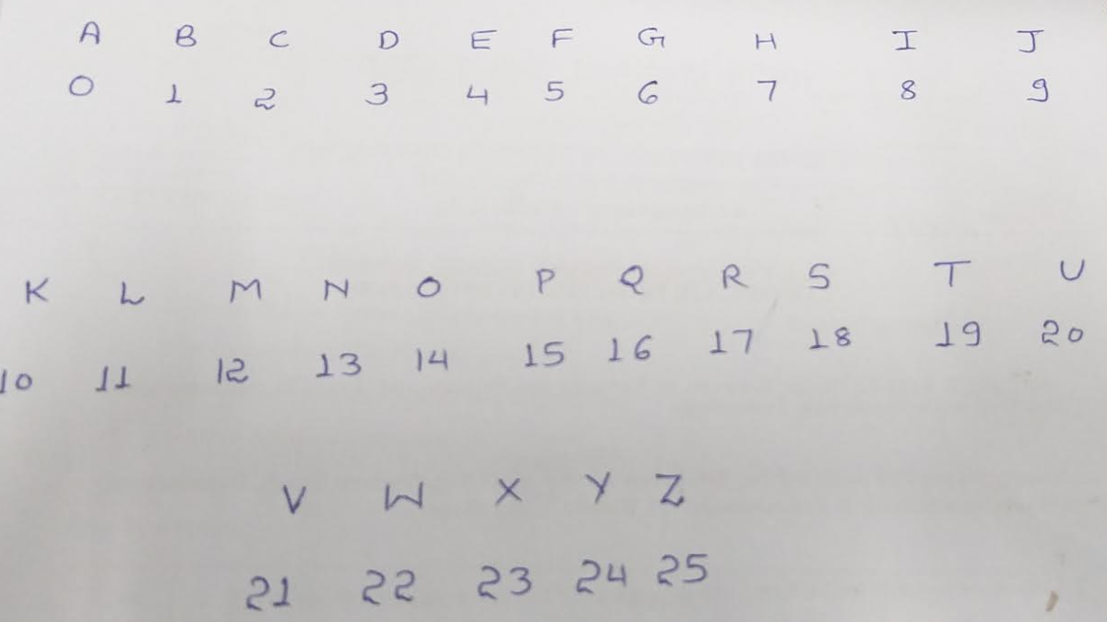
Vigenere Cipher
Encryption
Formula of encryption :
Ei = (Pi + Ki) mod 26
Formula of decryption :
Pi = (Ei - Ki) mod 26
Note: User can use mathematical logic or the table both are same.
Plaintext | C | O | M | P | U | T | E | R
P value | 2 | 14 | 12 | 15 | 20 | 19 | 4 | 17
Key | A | L | P | H | A | A | L | P
Key Value | 0 | 11 | 15 | 7 | 0 | 0 | 11 | 15
C value | 2 | 25 | 1 | 22 | 20 | 19 | 15 | 6
Ciphertext | C | Z | B | W | U | T | P | G

Slide 25
Vigenere Cipher
Decryption
Encrypted | C | Z | B | W | U | T | P | G
C value | 2 | 25 | 1 | 22 | 20 | 19 | 15 | 6
Key | A | L | P | H | A | A | L | P
Key value | 0 | 11 | 15 | 7 | 0 | 0 | 11 | 15
P value | 2 | 14 | 12 | 15 | 20 | 19 | 4 | 17
Plaintext | C | O | M | P | U | T | E | R
Formula of encryption :
Ei = (Pi + Ki) mod 26
Formula of decryption :
Pi = (Ei - Ki) mod 26
Note: User can use mathematical logic or the table both are same.

Slide 26
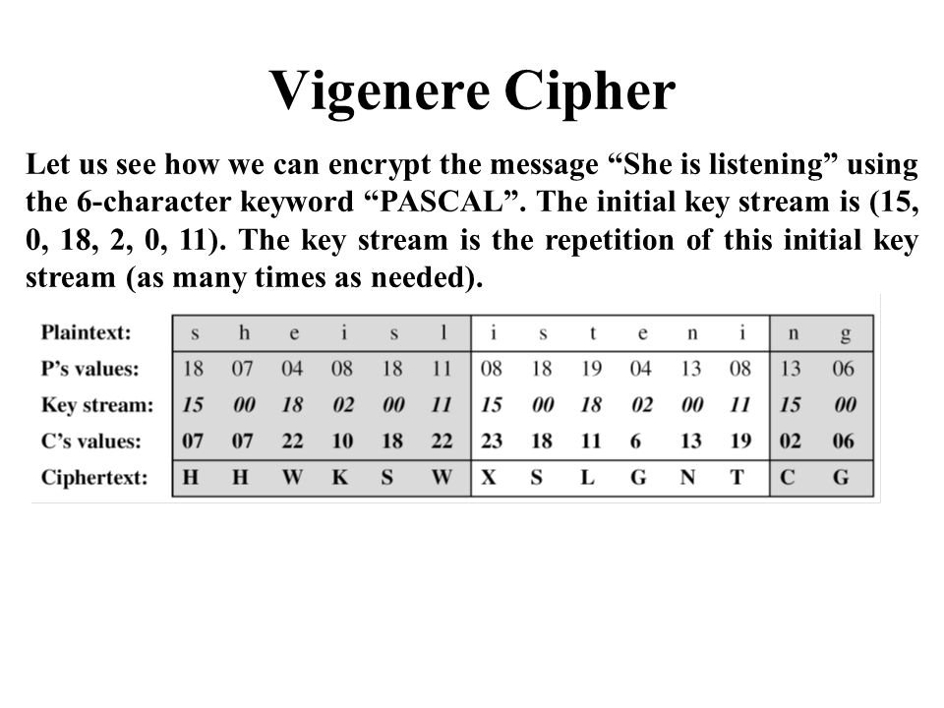

Slide 27
Attacks on Vigenere Cipher
The primary weakness of the Vigenère cipher is the repeating nature of its key.
If a cryptanalyst correctly guesses the key's length, the cipher text can be treated as interwoven Caesar ciphers, which can easily be broken individually.
The Kasiski examination and Friedman test can help to determine the key length.

Slide 28
Hill Cipher
A linear algebra based polygraphic substitution cipher.
Each letter is represented by a number from 0 to 25.
As A=0 , B=1, C=3, …… Z=25
Plaintext is transformed into a nx1 vector matrix.
For example if plaintext = ABC , a 3 row and 1 column matrix.
It will become [ ]
0
1
2
Notes:
https://www.codespeedy.com/hill-cipher-implementation/

Slide 29
Hill Cipher
Generating key square matrix
Key for this encryption method is a nxn matrix ( a square matrix always).
If key is 2x2 matrix then the plaintext is splitted into 2x1 matrix.
Let key is = HELP = HE LP = 2X2 matrix
And the key matrix becomes [ [7,4] , [11, 15] ]
NOTE: As the key matrix is always square matrix the given plaintext is required to be in even count, if not then some false character is added to the end inorder to make it even.
Using alphabets (from A=0) ABCDEFGHIJKLMNOPQRSTUVWXYZ
H | E
L | P
7 | 4
11 | 15
=

Slide 30
Hill Cipher
Encryption
Key Matrix
Plaintext = GO
For encryption a simple matrix multiplication is used:
H | E
L | P
7 | 4
11 | 15
=
[ nxn ] X [nx1] = [ nx1] mod 26
KeyMatrix X PlaintextVector = [ result ] mod 26
7 | 4
11 | 15
6
14
42 + 56
66 + 210
98
276
20
16
U
Q
G
O
6
14
X
=
=
mod 26 =
=
=

Slide 31
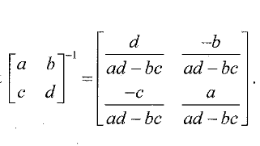
Hill Cipher
Decryption
Key Matrix
Plaintext = GO
Ciphertext
To decrypt the ciphertext we calculate the inverse of key matrix.
H | E
L | P
7 | 4
11 | 15
7 | 4
11 | 15
15/61 | -4/61
-11/61 | 7/61
Determinant of matrix
=(a*d - b*c)
=(7*15 - 4*11) = 61
=
Inverse is
mod 26
Determinant of matrix is 61 mod 26 = 9 mod 26
Modular multiplicative inverse of 9 mod 26 is 3 so new matrix becomes
G
O
6
14
=
45 | -12
-33 | 21
19 | 14
19 | 21
mod 26 =
mod 26
20
16
U
Q
=

Slide 32
Hill Cipher
Decryption
Key Matrix
Plaintext = GO
Ciphertext
[ nxn ] ⁻¹ X [nx1] = [ nx1] mod 26
H | E
L | P
7 | 4
11 | 15
=
InverseKeyMatrix X CiphertextVector = [ result ] mod 26
19 | 14
19 | 21
20
16
20x19 + 16x14
20x19 + 16x(21)
6
14
X
=
mod 26
=
G
O
6
14
=
380 + 224 =604
380 + 336 = 716
604
716
6
14
mod 26 =
mod 26 =
mod 26
20
16
U
Q
=

Slide 33
Hill Cipher : Question 2
Generating key square matrix
Key for this encryption method is a nxn matrix ( a square matrix always).
If key is 2x2 matrix then the plaintext is splitted into 2x1 matrix.
Let key is = DHFO = DH FO = 2X2 matrix
And the key matrix becomes [ [3,7] , [5, 13] ]
NOTE: As the key matrix is always square matrix the given plaintext is required to be in even count, if not then some false character is added to the end inorder to make it even.
Using alphabets (from A=0) ABCDEFGHIJKLMNOPQRSTUVWXYZ
D | H
F | O
3 | 7
5 | 13
=

Slide 34
Hill Cipher
Encryption
Key Matrix
Plaintext = GO
For encryption a simple matrix multiplication is used:
D | H
F | M
3 | 7
5 | 11
=
[ nxn ] X [nx1] = [ nx1] mod 26
KeyMatrix X PlaintextVector = [ result ] mod 26
3 | 7
5 | 13
8
5
24+35
40+65
59
105
7
1
G
B
I
F
8
5
X
=
=
mod 26 =
=
=

Slide 35
Hill Cipher
Decryption
Key Matrix
Plaintext = GO
Ciphertext
To decrypt the ciphertext we calculate the inverse of key matrix.
D | H
F | N
3 | 7
5 | 12
=
3 | 7
5 | 13
13/4 | -7/4
-5/4 | 3/4
Determinant of matrix
=(a*d - b*c)
=(3*13 - 7*5) = 4
Inverse is
mod 26
I
F
8
5
=
Determinant of matrix is 4 mod 26 = 4 , modular multiplicative inverse of 4 mod 26 does not exist so we need to stop here!
To find modular inverse of two numbers (a,b) the given numbers must satisfy
gcd(a,b) = 1
7
1
G
B
=

